Slide 1


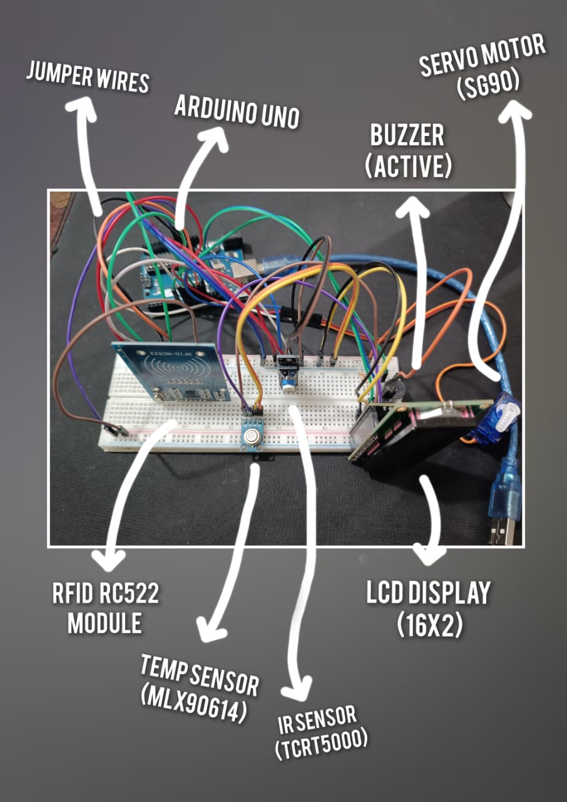

DOOR SECURITY ENHANCED WITH RFID MODULE AND TEMPERATURE SENSOR /:
ME (Sec: B)

Slide 2

OBJECTIVE:
To design and implement a secure and efficient system for locking and unlocking doors using RFID technology, providing convenience, reliability, and accessibility for authorized users, while maintaining the safety and privacy of the premises.

Slide 3

Methodology
Install RC522 RFID reader and MLX90614 temperature sensor to the door lock system.
Store multiple slave tags in the master tag for multiple user access.
Program the system to read the temperature using the MLX90614 sensor.
If the temperature readings exceed a certain threshold, the door will not open.
The system will check for a valid RFID tag and compare it with the stored tags in the master tag.
If a match is found, the door will unlock. If not, the door remains locked.
Repeat the process for every door access attempt.

Slide 4

COMPONENTS AND PRICE:
The following list of components will be required for this project:
Arduino UNO R3 ---------------------------------------> 1100 tk
RFID RC522 Module (1 unit) ------------------------> 188 tk
MLX90614 Sensor (1 unit) --------------------------> 1400 tk
LCD Display with I2C module (1 unit) ------------> 350 tk
Active Buzzer (1 unit) --------------------------------> 15 tk
TCRT5000 IR Sensor (1 unit) ------------------------> 100 tk
SG90 Servo Motor (1 unit) --------------------------> 150 tk
1.5V Batteries (4 units) -------------------------------> 80 tk
Jumper wires (2 sets) ---------------------------------> 250 tk
Total Cost: 3540 tk

Slide 5
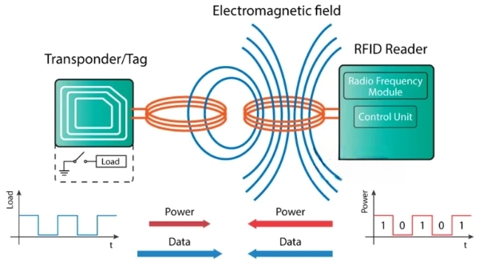
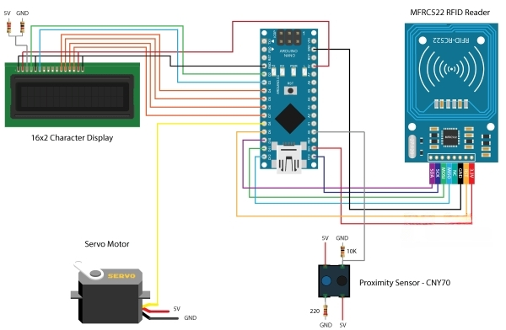
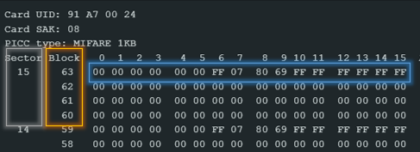
RFID and Circuit Diagram
Fig: Working principle of Tag
Fig: Circuit Diagram of the Project
Fig: 16 bytes of data (blue box)

Slide 7

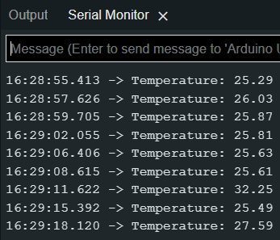

Slide 8
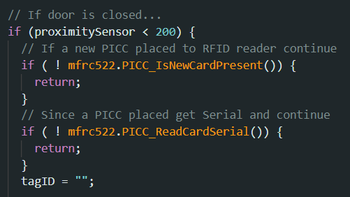
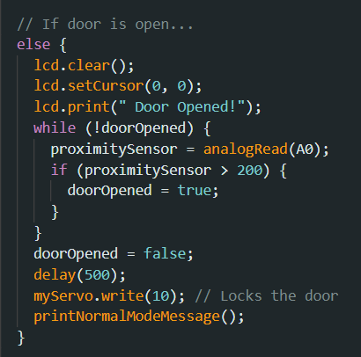

Slide 9


Increased security: RFID provides secure access control by assigning unique identification to authorized users and allowing only those users to unlock the door.
Convenience: The use of RFID makes it easier for users to access the door without having to manually enter a password or carry a physical key.
Integration with temperature sensor: By combining the MLX90614 temperature sensor with the RFID system, you can implement additional safety measures, such as denying access to individuals with elevated temperatures (e.g., due to illness).
Advantages & Drawbacks
Cost: Implementing such a system can be more expensive compared to traditional locking systems.
Technical expertise: Setting up and maintaining the system may require technical expertise.
Dependence on technology: The system relies on technology, which means it could potentially malfunction or be disrupted.
Privacy concerns: The use of RFID and temperature sensors raises privacy concerns as it involves the collection and storage of personal data.

